Slide 1
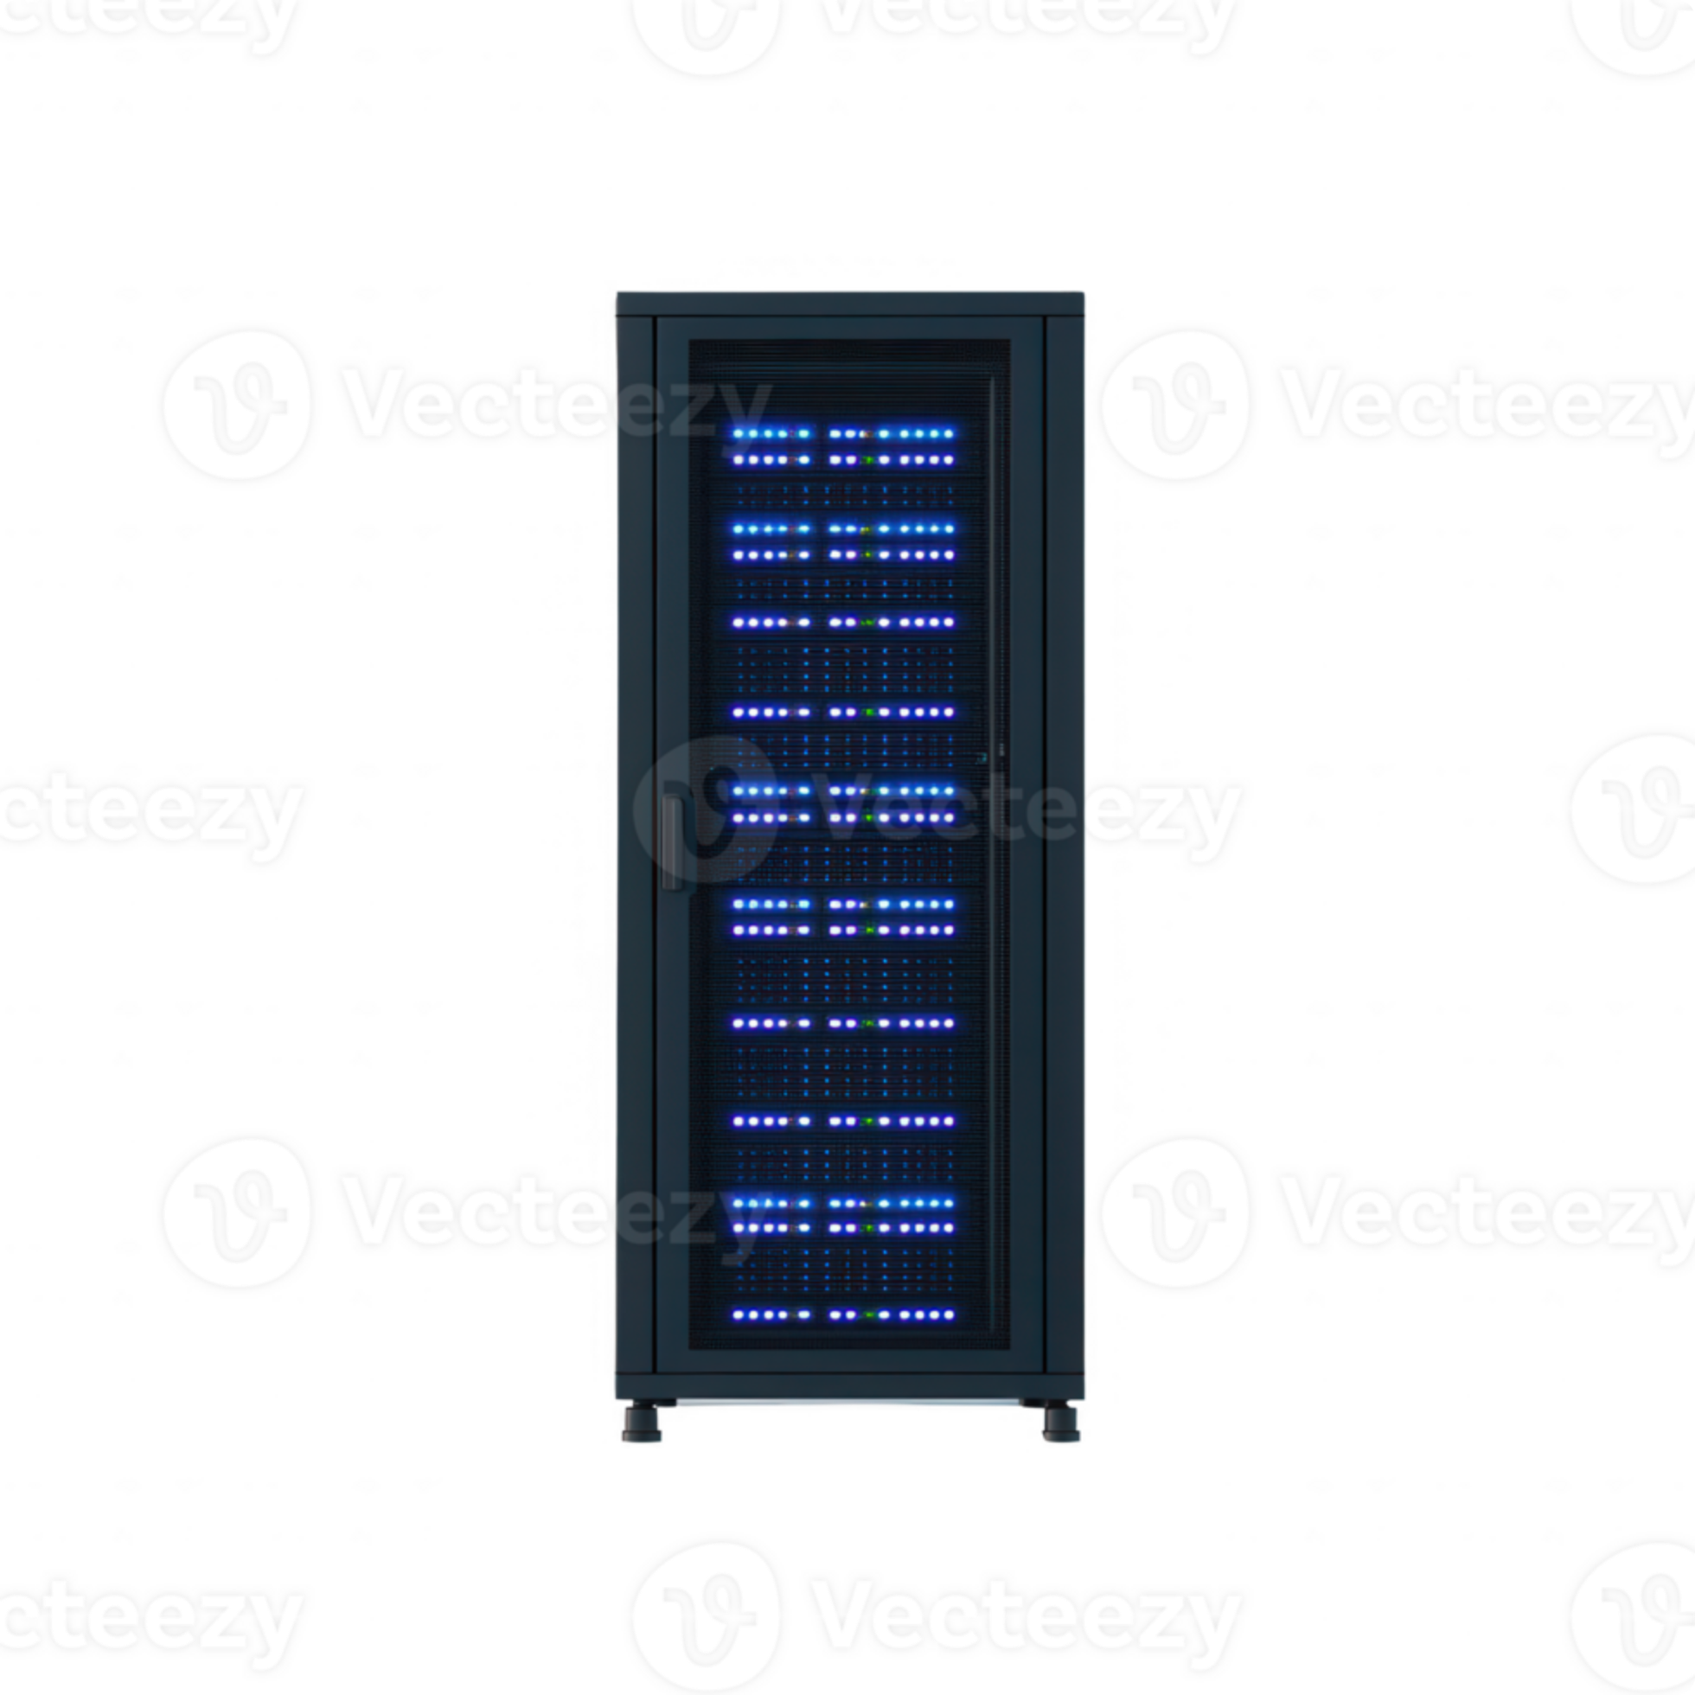
Self-Hosted Personal Cloud and Media Server
Name: Jatin Tasoria · UID: 25MCC20054
A Fedora-based self-hosted server providing personal cloud storage and media streaming using open-source technologies.

Slide 2
Project Objectives
Secure Self-Host
Centralized Sync
Develop a secure personal cloud storage solution under full user control.
Provide centralized file storage and synchronization across multiple devices.
Automatic Backups
Secure Streaming
Automate backups from legacy Android devices to the server.
Enable private media streaming and authenticated file access.
Linux & Containers
Cost & Privacy
Demonstrate server administration with Fedora, Docker, and Docker Compose.
Deliver a cost-effective, privacy-focused alternative to commercial clouds.

Slide 3
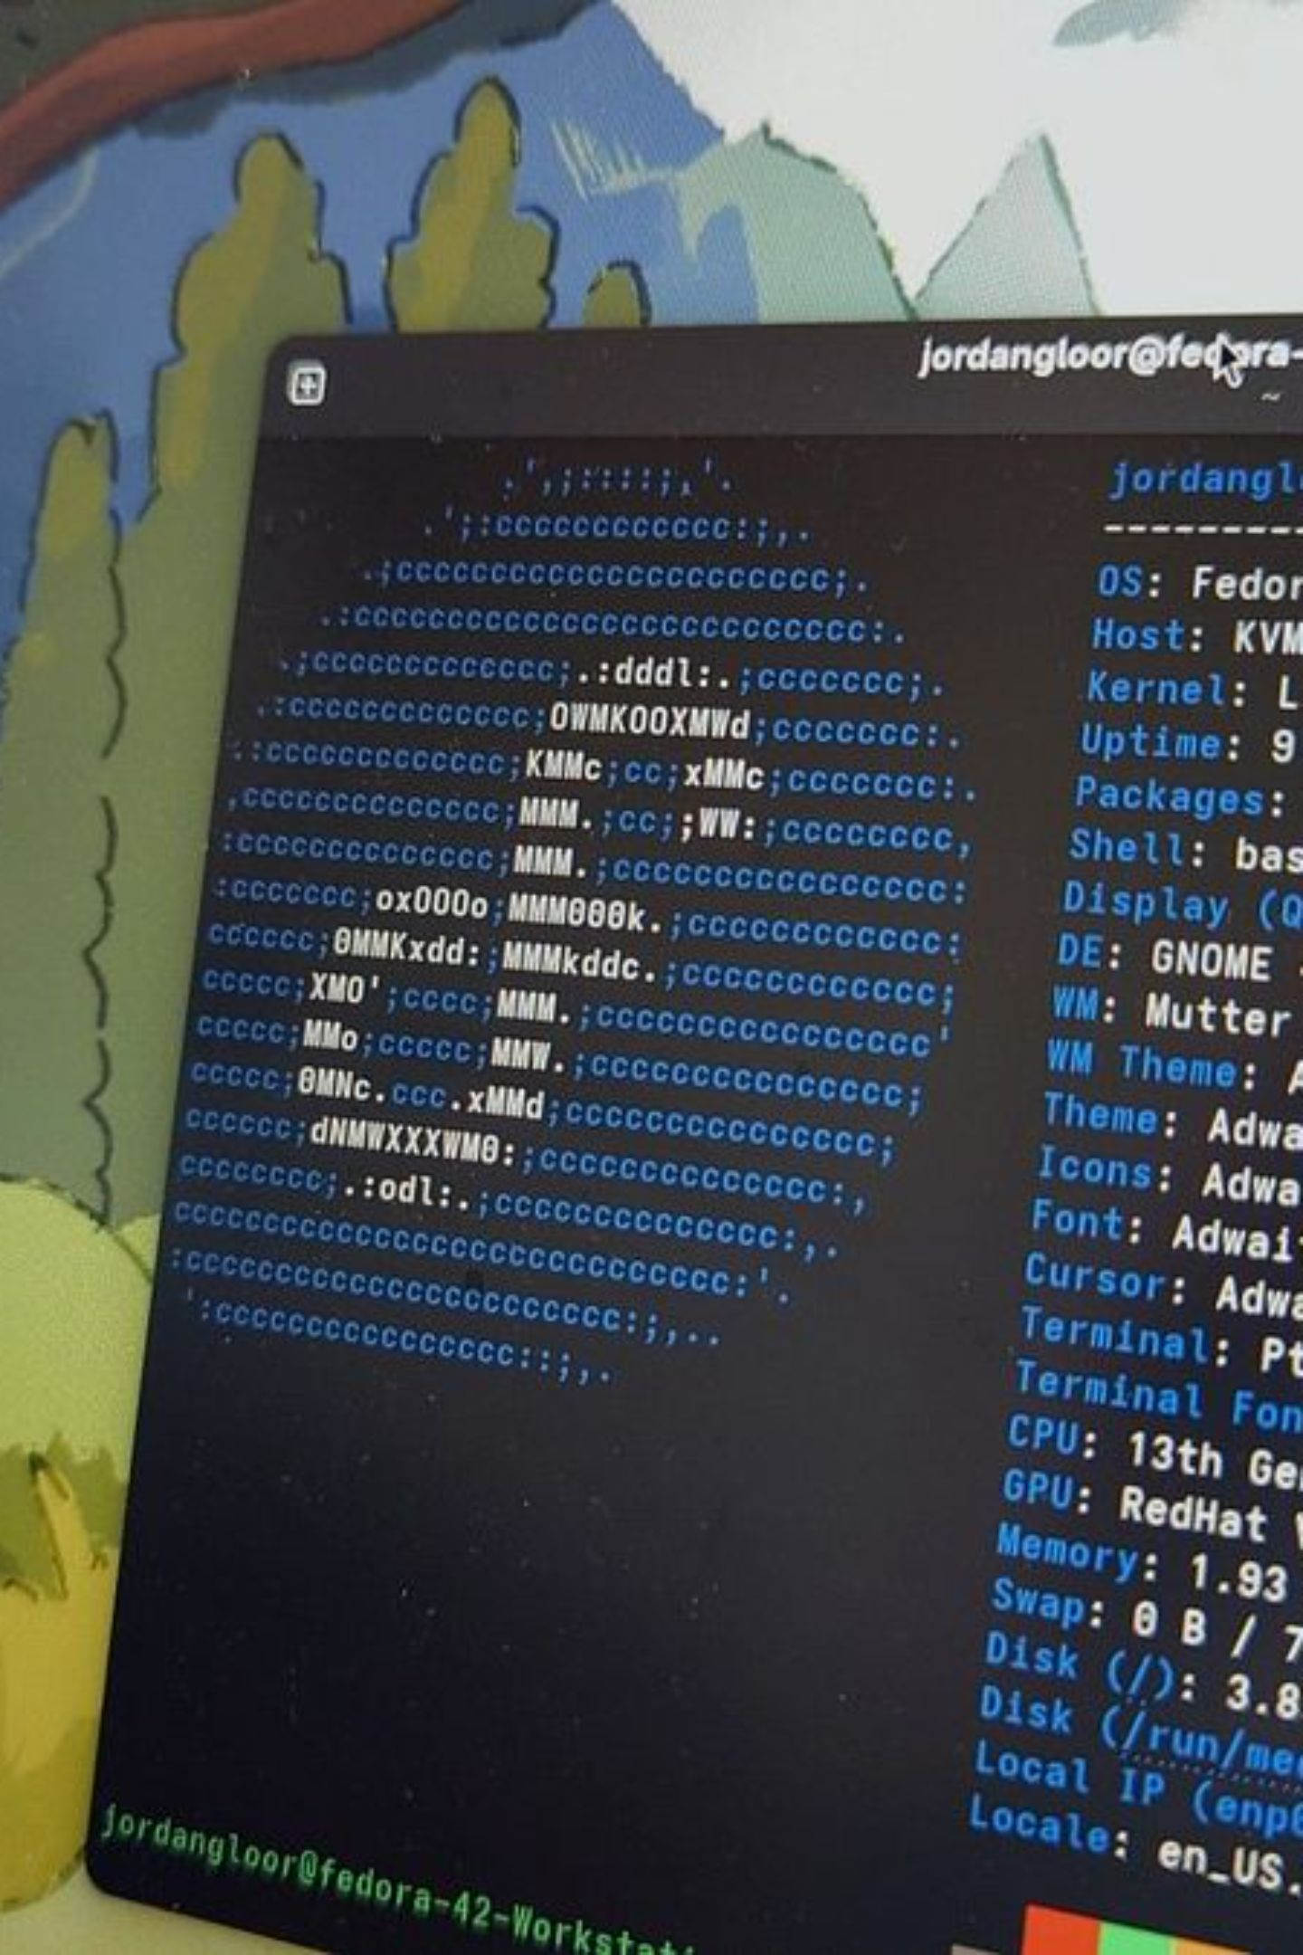

Phase 1 — Server & Storage Setup
Core infrastructure provisioned and prepared for containerized services.
128 GB SSD
Fedora Linux
Docker & Compose
2 TB HDD /srv/storage
Key components: Fedora OS on 128 GB SSD, secondary 2 TB HDD for media and Nextcloud data, Docker for service isolation, SSH and Git for administration/version control.

Slide 4
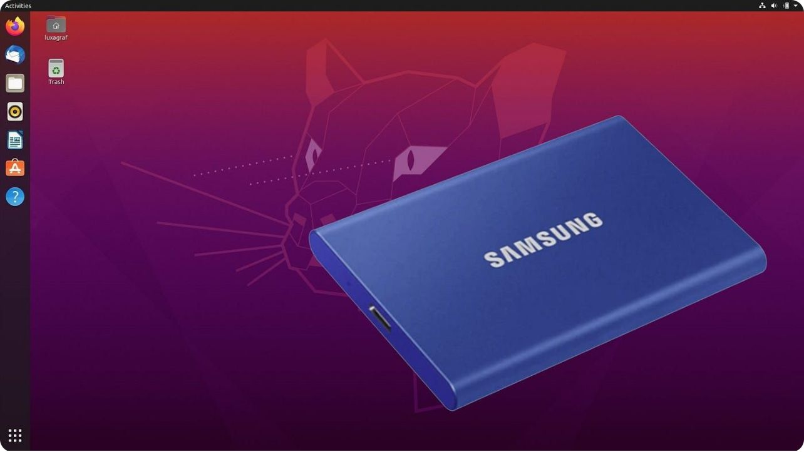
Storage Management
/srv/storage structure and mount strategy:
HDD mounted at /srv/storage with UUID entries in /etc/fstab
nofail option used so the system boots when HDD absent
Separate directories for content types for easy mapping in Docker
Directory tree:
/srv/storage
├── Movies
├── TV_Shows
├── Anime
├── Anime_Movies
└── NEXTCLOUD
Useful commands: lsblk, sudo blkid, sudo mkdir -p /srv/storage, sudo mount -a, df -h

Slide 5
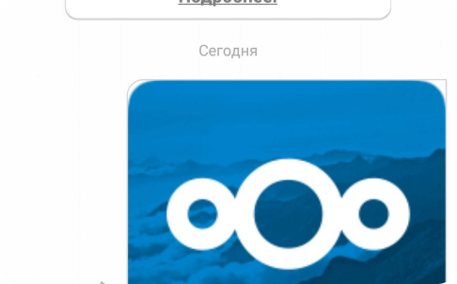

Phase 2 — Service Deployment
Deploying core services in Docker containers, mapped to persistent storage on /srv/storage.
Nextcloud — Personal Cloud
Jellyfin — Media Server
Centralized file storage, synchronization, and Android automatic backups (Nextcloud mobile app).
Self-hosted media streaming for Movies, TV Shows, Anime, and Music; libraries mapped from /srv/storage.
Both services run via Docker Compose with mapped volumes to persistent HDD partitions.

Slide 6

Nextcloud & Jellyfin — Configuration & Testing
Nextcloud
Deployed with Docker Compose, persistent storage at /srv/storage/NEXTCLOUD
Configured user accounts, tested file upload and device sync
Nextcloud Android app used to schedule automatic backups
Jellyfin
Deployed with Docker Compose, media libraries mapped from /srv/storage (Movies, TV_Shows, Anime, Music)
Configured libraries, metadata fetching, and transcoding settings
Tested local and remote media playback on Android and web clients
Common Docker commands used: docker compose up -d, docker ps, docker logs <container-name>

Slide 7

Current Progress & Next Steps (Phase 3 Preview)
Completed
Phase 3 Preview
Fedora server, Docker, SSH, 2TB HDD, Nextcloud & Jellyfin deployed and tested.
Enable secure remote access, reverse proxy, and final verification.
Detailed next steps:
Configure Tailscale for secure verification and remote connectivity.
Verify service behavior and stability before exposing to the public internet.
Deploy Nginx as a reverse proxy, enable TLS and HTTP auth where appropriate.
Test system from multiple devices and finalize troubleshooting.
Prepare final documentation and demo script.
Workflow mantra: Build → Deploy → Verify → Secure

